Slide 2
HOW MOBILE TOWER WORKS

Slide 3


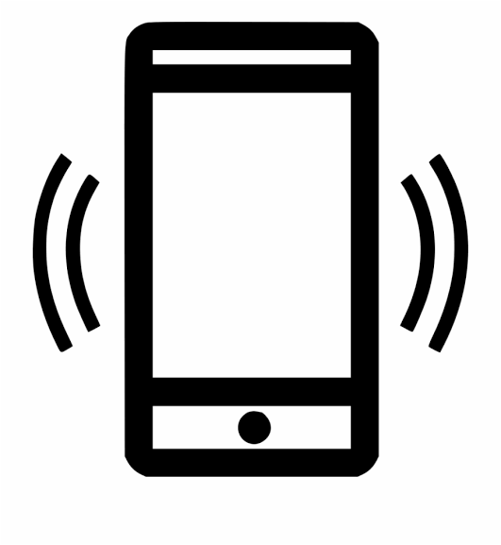

Slide 4
Types of Mobile Generation
1G
2G
3G
4G
5G
1979
1991
2001
2009
2018
Launched In Japan By Nippon Telegraph And Telephone (NTT)
Launched On The GSM Standard In Finland
GPRS
EDGE
40 kbit/s-384 kbit/s
WCDMA, HSPA
2 Mbit/s-7.2Mbit/sec
LTE , WiMAX,
5.5 Mbps-
18.8Mbps
Some place Testing level
20 gigabits/Sec

Slide 5
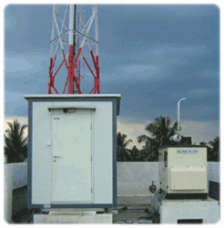
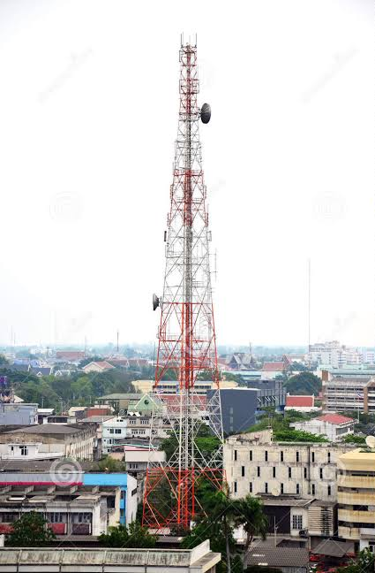
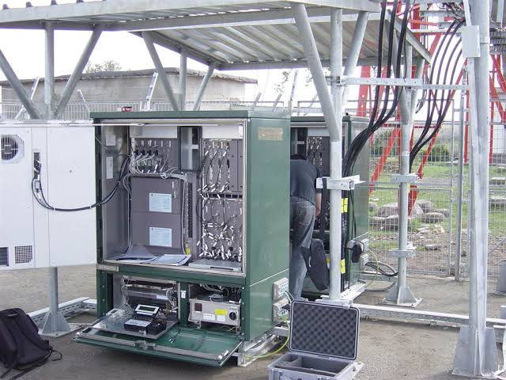

Slide 6
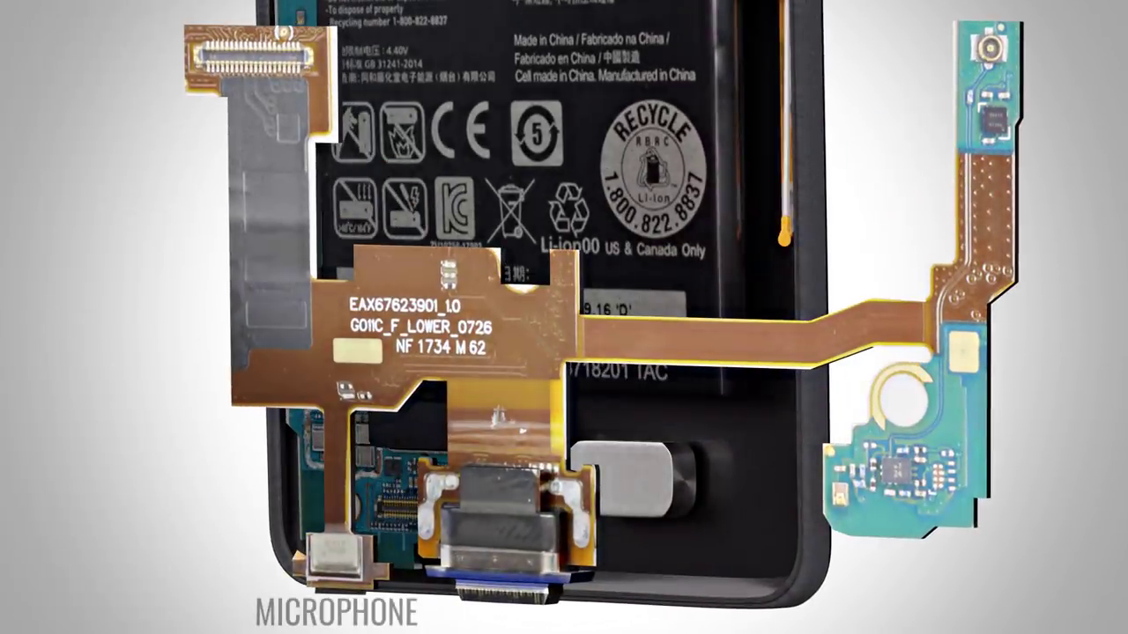
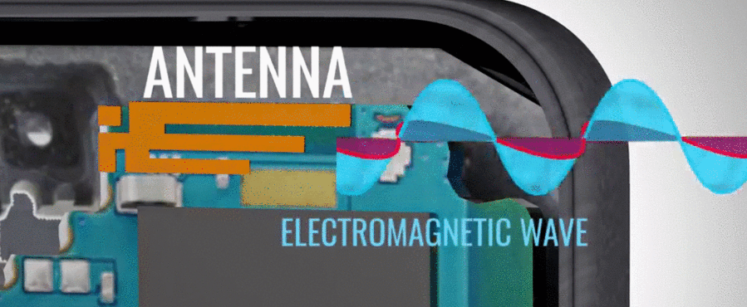
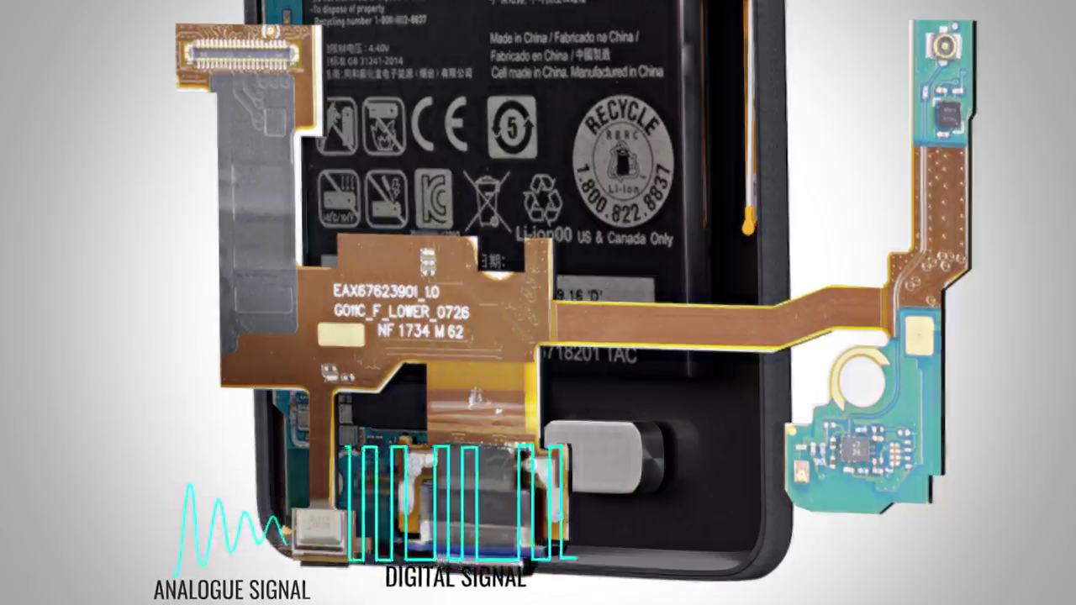

Slide 7
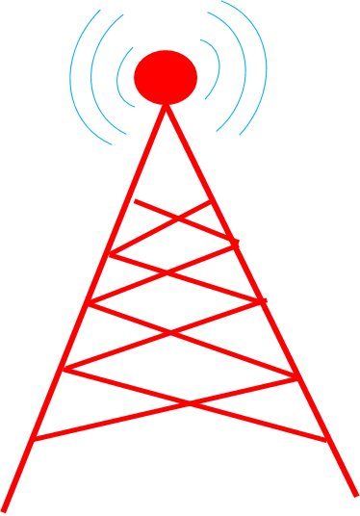
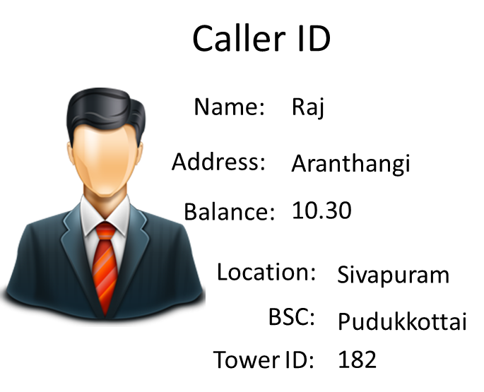

Base Station Controller
(BSC)
Mobile Switching Centre
(MSC)
Base Transceiver Station

Slide 8




MSC
Anu
Trichy
20.56
Thillai Nagar
Thillai Nagar
056

Slide 9
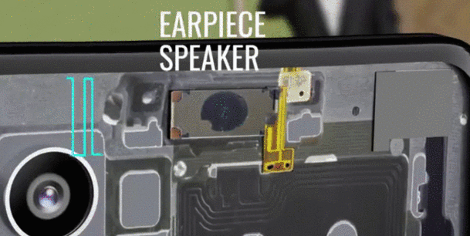

Slide 10
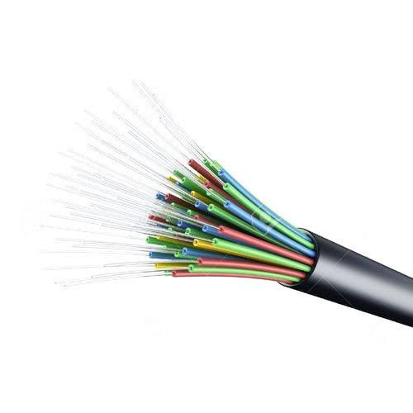
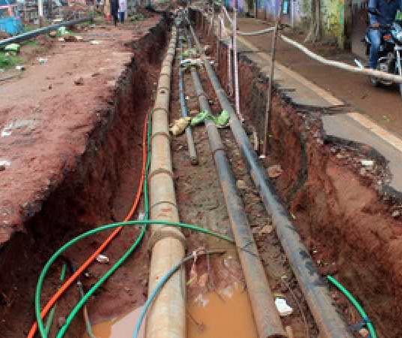
Fiber Optic cable

Slide 11
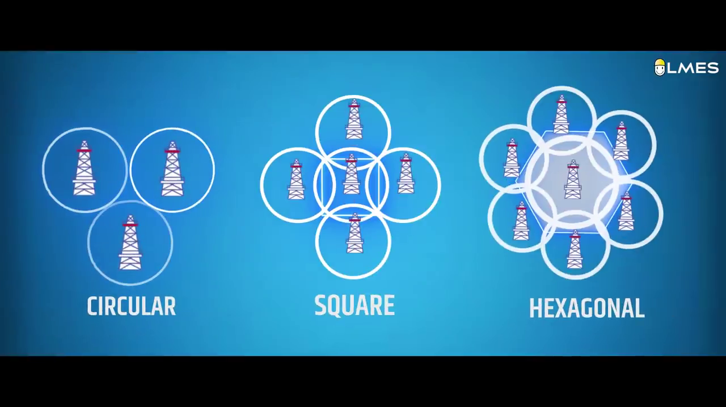
Tower Pattern

Slide 12
Thank you

